Slide 1
COMP 3500 Introduction to Operating Systems The Banker’s Algorithm (Part 2)
Dr. Xiao Qin
Auburn University http://www.eng.auburn.edu/~xqin
xqin@auburn.edu
Notes:
2018 Fall:
HW2 hint given in Lec 26 rather than Lec 25.
2017Fall:
HW2 hint given in Lec 24 rather than Lec 25.
Spring’17:
HW2 hints: 8 Min.
35 Minutes: Slides 1-6

Slide 4
Review: How to update the Allocation and Need Matrices? P₁ requests (1,0,2)
Allocation Max Available
A B C A B A B C
P₀ 0 1 0 7 5 3 3 3 2
P₁ 2 0 0 3 2 2
P₂ 3 0 2 9 0 2
P₃ 2 1 1 2 2 2
P₄ 0 0 2 4 3 3
1: Can the request of P1 be granted? Why?
Before
Check that Request ≤ Available (that is, (1,0,2) ≤ (3,3,2) ⇒ true
Allocation Need Available
A B C A B C A B C
P₀ 0 1 0 7 4 3 2 3 0
P₁ 3 0 2 0 2 0
P₂ 3 0 2 6 0 0
P₃ 2 1 1 0 1 1
P₄ 0 0 2 4 3 1
2: How to update the “Allocation”, “Need”, and Available data?
After

Slide 5
Review: How to determine if a request should be granted?
Allocation Need Available
A B C A B C A B C
P₀ 0 1 0 7 4 3 2 3 0
P₁ 3 0 2 0 2 0
P₂ 3 0 2 6 0 0
P₃ 2 1 1 0 1 1
P₄ 0 0 2 4 3 1
Given a sequence of <P4, P0>,
Can request for (3,3,0) by P₄ be granted? Why?
Can request for (0,2,0) by P₀ be granted?
Notes:
Q3: No. request > available

Slide 6
Teaching Challenge: Safe State
When a process requests a resource, system must decide if allocation leaves the system in a safe state
System is in safe state if there exists a sequence <P₁, P₂, …, P_{n}> of ALL the processes in the systems such that for each P_{i}, the resources that P_{i} can still request can be satisfied by currently available resources + resources held by all the P_{j}, with j < I
Notes:
When a process requests a resource, system must decide if allocation leaves the system in a safe state
System is in safe state if there exists a sequence <P₁, P₂, …, P_{n}> of ALL the processes in the systems such that for each P_{i}, the resources that P_{i} can still request can be satisfied by currently available resources + resources held by all the P_{j}, with j < I
That is:
If P_{i} resource needs are not immediately available, then P_{i} can wait until all P_{j} have finished
When P_{j} is finished, P_{i} can obtain needed resources, execute, return allocated resources, and terminate
When P_{i} terminates, P_{i +1} can obtain its needed resources, and so on

Slide 7

Exercise 1. Please discuss with your group members to study how does the following safety algorithm check if a system is in a safe state. What is Work? Why Work = Work + Allocation_{i} in step 3?
1. Let Work and Finish be vectors of length m and n, respectively. Initialize:
Work = Available
Finish [i] = false for i = 0, 1, …, n- 1
2. Find an i such that both:
(a) Finish [i] = false
(b) Need_{i} ≤ Work
If no such i exists, go to step 4
3. Work = Work + Allocation_{i} Finish[i] = true go to step 2
4. If Finish [i] == true for all i, then the system is in a safe state
n is the number of processes, m is the number of resource types
Notes:
Work = Work + Allocation_i: means process_i release its allocation_i back to the system.

Slide 8

Exercise 2: The Resource-Request Algorithm for Process P_{i}
Request_{i} = request vector for process P_{i}. If Request_{i} [j] = k then process P_{i} wants k instances of resource type R_{j}
1. If Request_{i} ≤ Need_{i} go to step 2. Otherwise, raise error condition, since process has exceeded its maximum claim
2. If Request_{i} ≤ Available, go to step 3. Otherwise P_{i} must wait, since resources are not available
3. Pretend to allocate requested resources to P_{i} by modifying the state as follows:
Available = Available – Request_{i};
Allocation_{i} = Allocation_{i} + Request_{i};
Need_{i} = Need_{i} – Request_{i};
If safe, then the resources are allocated to P_{i}
If unsafe, then P_{i} must wait, and the old resource-allocation state is restored
Conditions?
How to modify the state?
Notes:
<=

Slide 9
Deadlock Detection
Allow system to enter deadlock states
A detection algorithm
A recovery scheme
Notes:
Slides 7-17 can be found in 09b1-Deadlock Detection.

Slide 10

Exercise 3. How to detect deadlocks in a system where there is a single instance per resource type?
Maintain wait-for graph
Nodes are processes
P_{i} → P_{j} if P_{i} is waiting for P_{j}
Periodically invoke an algorithm that searches for a cycle in the graph. If there is a cycle, there exists a deadlock
An algorithm to detect a cycle in a graph requires an order of n² operations, where n is the number of vertices in the graph

Slide 11
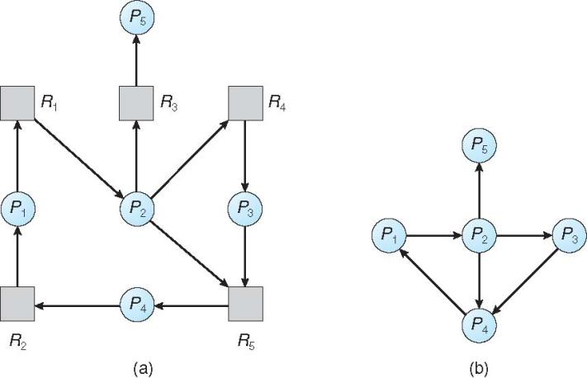

Exercise 4. Resource-Allocation Graph and Wait-for Graph. You need to remove all the resources from the graph.
Please draw a corresponding
wait-for graph.
Resource-Allocation Graph
Corresponding wait-for graph

Slide 12
Several Instances of a Resource Type
Available: A vector of length m indicates the number of available resources of each type
Allocation: An n x m matrix defines the number of resources of each type currently allocated to each process
Request: An n x m matrix indicates the current request of each process. If Request [i][j] = k, then process P_{i} is requesting k more instances of resource type R_{j}.

Slide 13
Detection Algorithm
1. Let Work and Finish be vectors of length m and n. Initialize:
(a) Work = Available
(b) For i = 1,2, …, n, if Allocation_{i} ≠ 0, then Finish[i] = false; otherwise, Finish[i] = true
2. Find an index i such that both:
(a) Finish[i] == false
(b) Request_{i} ≤ Work
If no such i exists, go to step 4
3. Work = Work + Allocation_{i} Finish[i] = true go to step 2
4. If Finish[i] == false, for some i, 1 ≤ i ≤ n, then the system is in deadlock state. Moreover, if Finish[i] == false, then P_{i} is deadlocked
n is the number of processes, m is the number of resource types
What is do you observe in this
detection algorithm?
What is the time complexity?
Time Complexity: O(m x n²)
Notes:
Similar to the safety algorithm.
Request_i <= Work.

Slide 14
Example of Detection Algorithm
Five processes P₀ through P₄; three resource types A (7 instances), B (2 instances), and C (6 instances)
Snapshot at time T₀:
Allocation Request Available
A B C A B C A B C
P₀ 0 1 0 0 0 0 0 0 0
P₁ 2 0 0 2 0 2
P₂ 3 0 3 0 0 0
P₃ 2 1 1 1 0 0
P₄ 0 0 2 0 0 2
Sequence <P₀, P₂, P₃, P₁, P₄> will result in Finish[i] = true for all i
What happens if
(0 0 1) requested by P2?
Notes:
What does “Finish[i] = true for all i” mean?

Slide 15
Example (Cont.)
P₂ requests an additional instance of type C
Request
A B C
P₀ 0 0 0
P₁ 2 0 2
P₂ 0 0 1
P₃ 1 0 0
P₄ 0 0 2
State of system?
Can reclaim resources held by process P₀, but insufficient resources to fulfill other processes; requests
Deadlock exists, consisting of processes P₁, P₂, P₃, and P₄

Slide 16
Detection-Algorithm Usage
When, and how often, to invoke depends on:
How often a deadlock is likely to occur?
How many processes will need to be rolled back?
one for each disjoint cycle
If detection algorithm is invoked arbitrarily, there may be many cycles in the resource graph and so we would not be able to tell which of the many deadlocked processes “caused” the deadlock.

Slide 17

Recovery from Deadlock: Process Termination
Abort all deadlocked processes
Abort one process at a time until the deadlock cycle is eliminated
In which order should we choose to abort?
Priority of the process
How long process has computed, and how much longer to completion
Resources the process has used
Resources process needs to complete
How many processes will need to be terminated
Is process interactive or batch?
Which one do you prefer? Why?
Notes:
Abort all: easy implementation
Abort one: good performance

Slide 18
Recovery from Deadlock: Resource Preemption
Selecting a victim – minimize cost
Rollback – return to some safe state, restart process for that state
Starvation – same process may always be picked as victim, include number of rollback in cost factor

Slide 19
Summary
The Banker’s Algorithm
The Safety Algorithm
Resource-Request Algorithm
The detection algorithm
The recovery scheme

